Slide 1
Generative AI and Large Language Models (LLMs)

Slide 2
Lecture Overview
Module 2 covers the basics of generative AI and Large Language Models (LLMs) like GPT, exploring their architecture and real-world applications. The practical part features a case study on integrating LLMs into projects, such as InstantAlfred on Insurancemarket.ae, showcasing their business impact.

Slide 3
Learning Objectives
By the end of this lecture, students will be able to:
Understand the core principles of generative AI.
Learn the architecture and workings of Large Language Models (LLMs) like GPT.
Explore real-world applications of LLMs across various industries.
Analyze a case study on integrating LLMs into business processes.
Gain practical insights into leveraging LLMs for project implementation.

Slide 4

What is Generative AI?

Slide 5
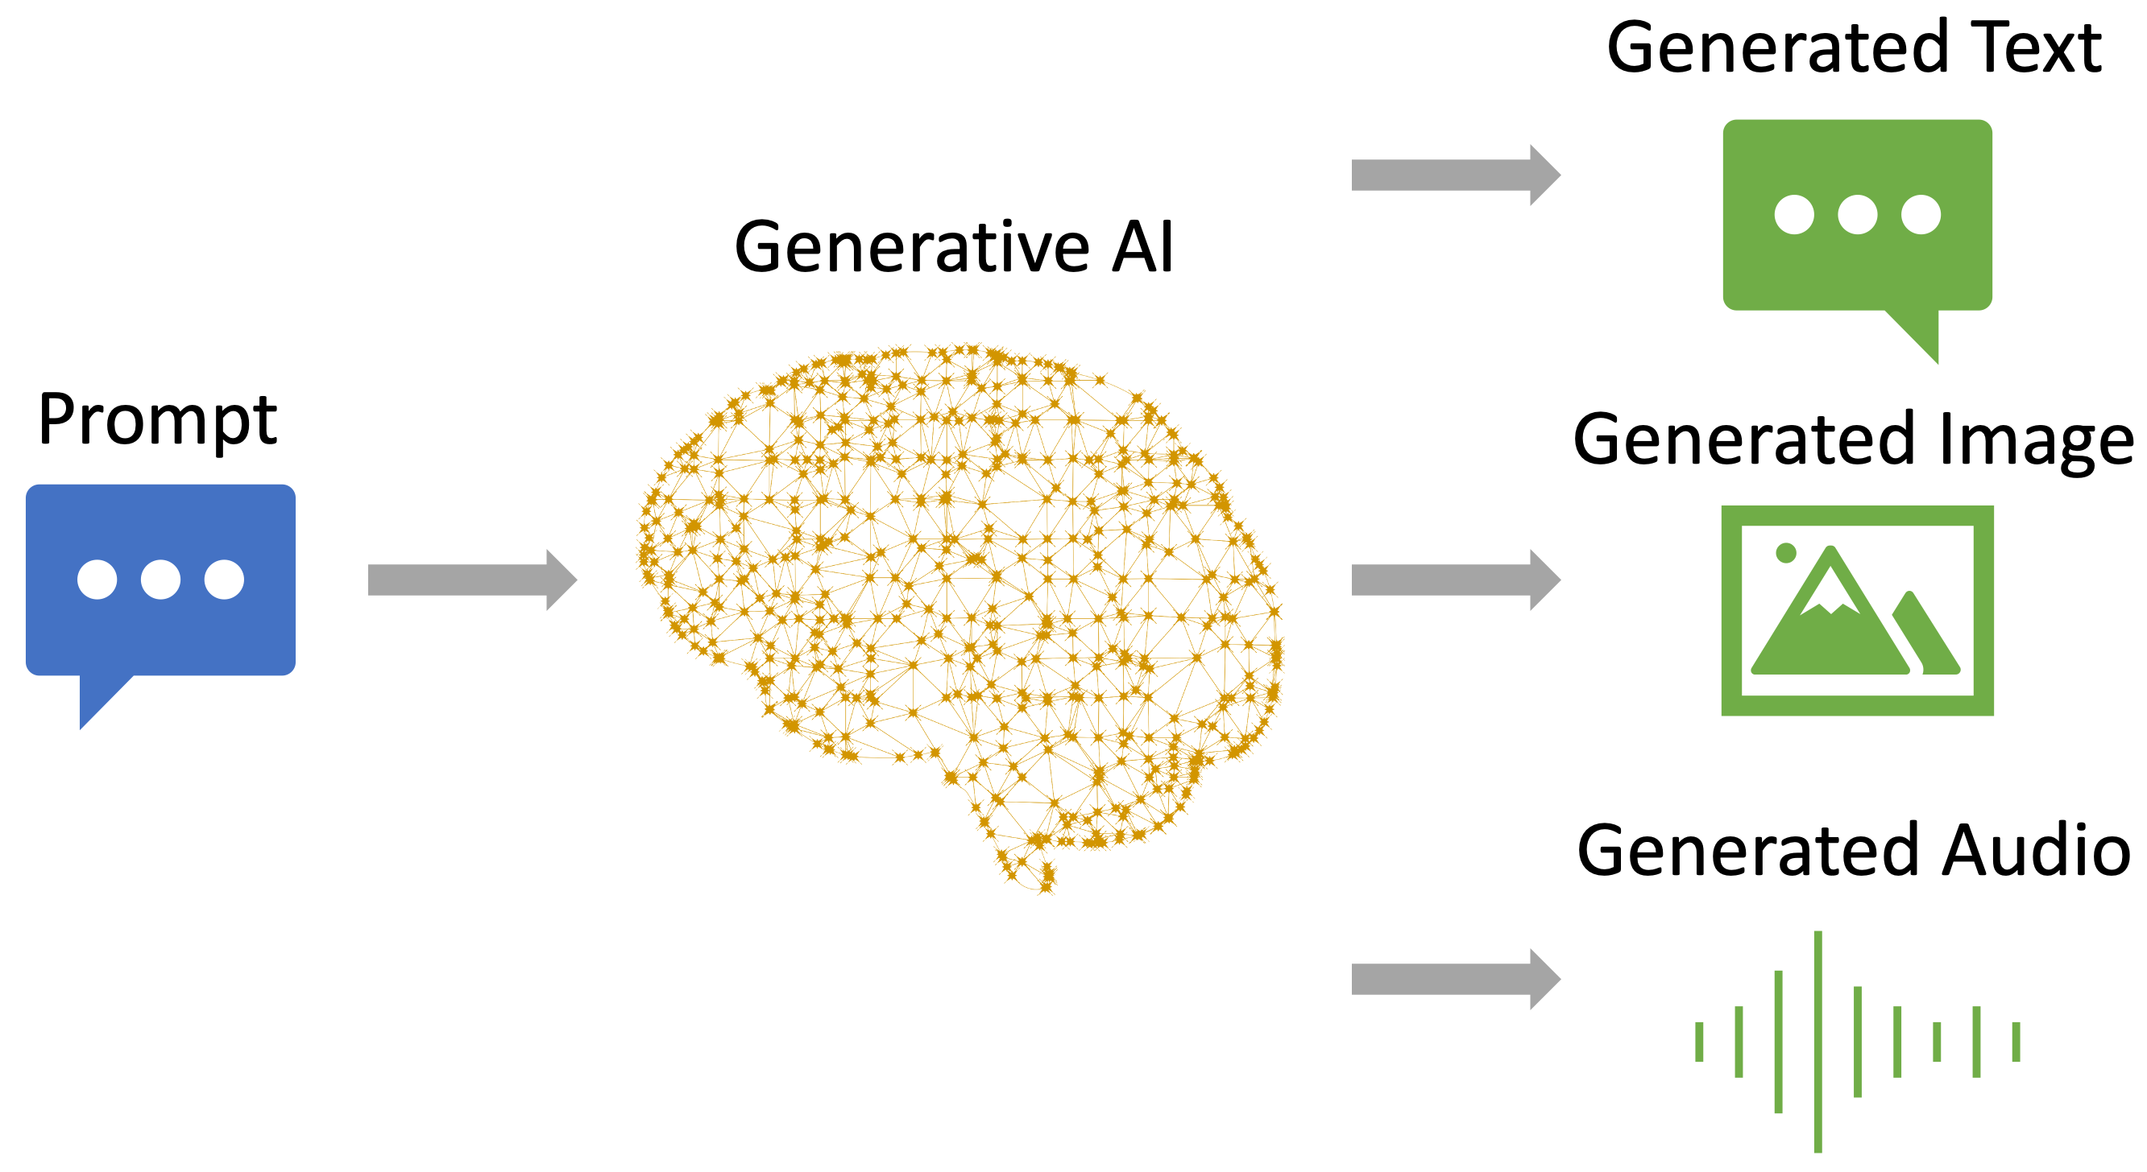
What is Generative AI?
Generative AI is a type of artificial intelligence that creates new content, such as text, images, or music, by learning from existing data. It uses algorithms to produce original data that mimics the patterns and styles found in the data it was trained on. Examples include AI systems that can write stories, draw pictures, or compose music based on what they have learned from large amounts of similar content.

Slide 6
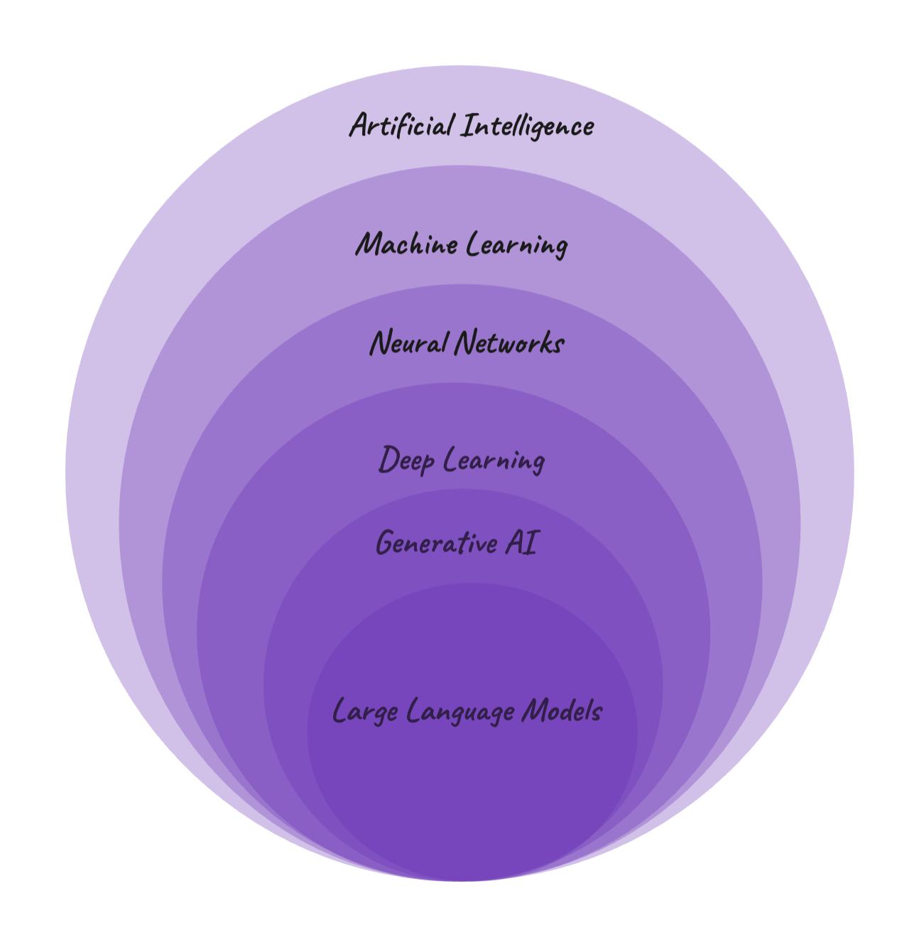

Slide 7
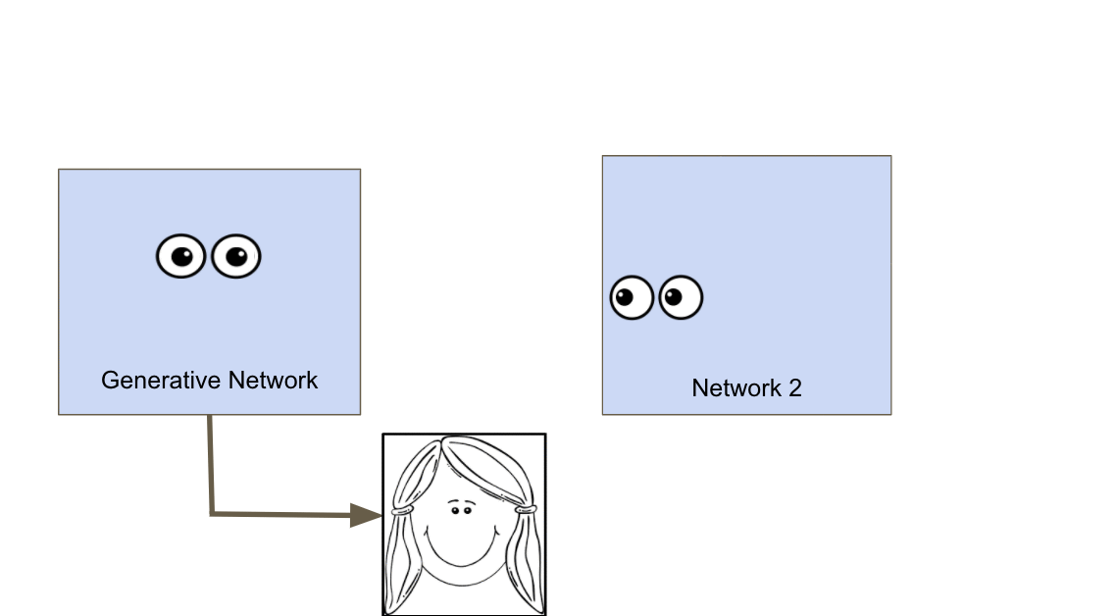
Generative Adversarial Networks
A Generative Adversarial Network (GAN) is a type of machine learning model used in generative AI. It consists of two neural networks: a generator and a discriminator.
The generator creates new, fake data (like images or text) that tries to mimic real data.
The discriminator evaluates the generated data and tries to determine whether it's real (from the original dataset) or fake (created by the generator).

Slide 8
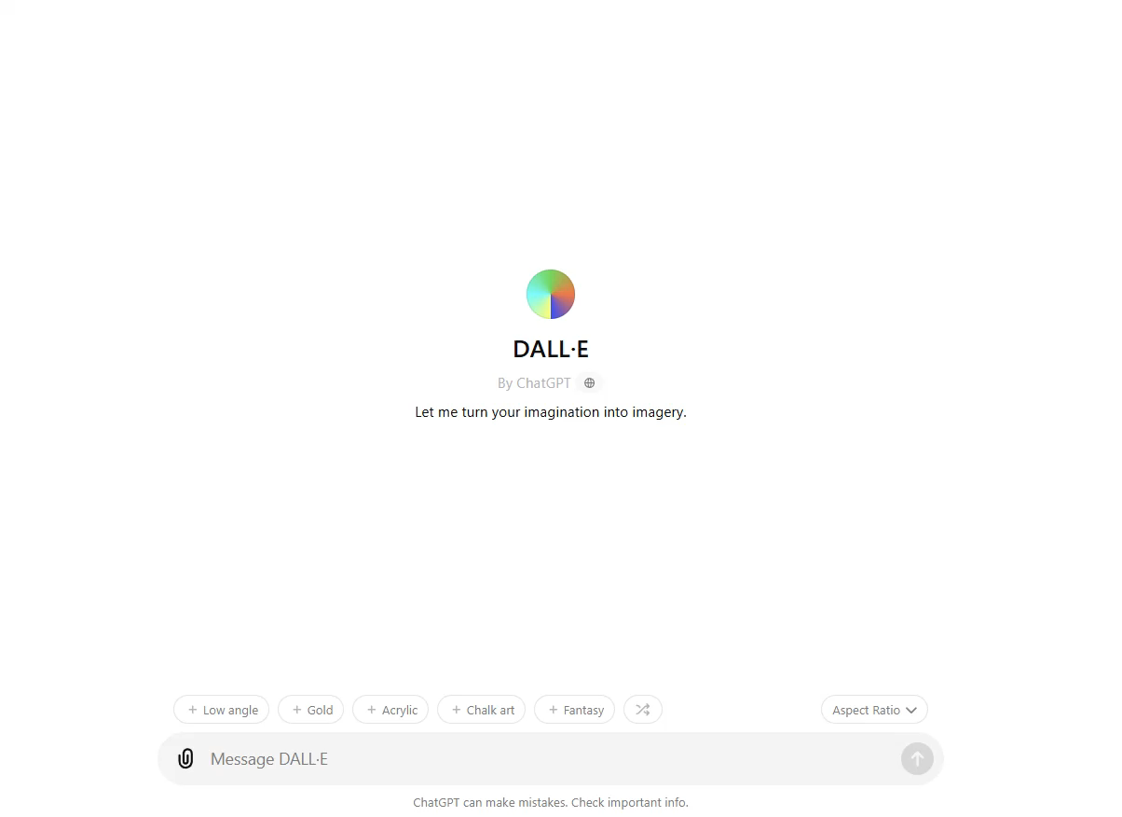
Examples

Slide 9
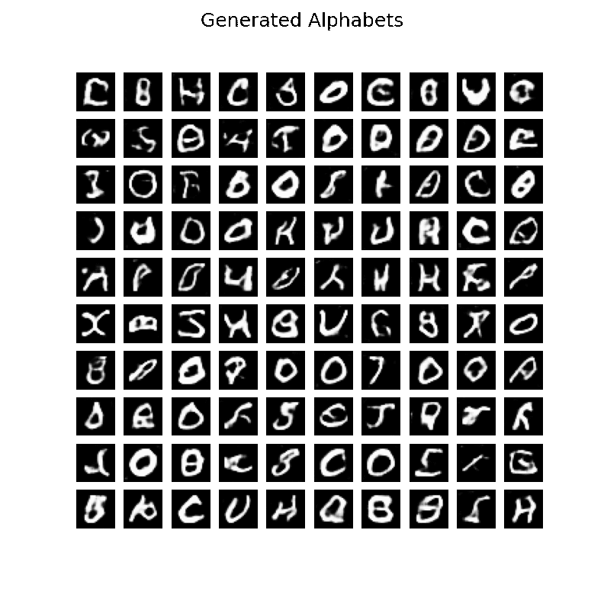
Examples

Slide 10
LARGE LANGUAGE MODELS

Slide 11
Language models are a type of artificial intelligence designed to understand, generate, and manipulate human language. They are trained on vast amounts of text data and use this training to predict and generate text that is coherent and contextually relevant.

Slide 12
Recurrent Neural Network
A Recurrent Neural Network (RNN) is a type of artificial neural network designed to process sequential data, such as time series, text, or speech. Unlike traditional neural networks, RNNs have a memory component that allows them to retain information from previous inputs, making them particularly suited for tasks where the order of data matters.

Slide 13
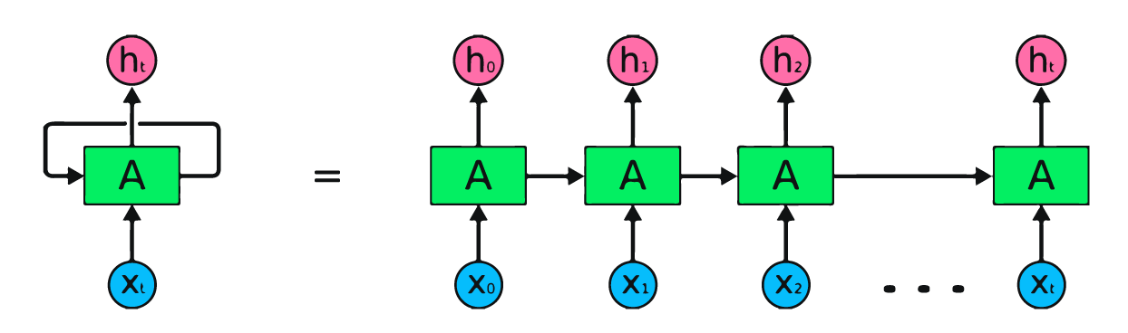

Slide 14
Recurrent Neural Network
Sequential data processing
Too much computation
During translation sequence is not considered
Memory is limited

Slide 15
Transformers
Transformers are a type of deep learning model that have become essential for tasks like language understanding and text generation. They replaced older models like RNNs because they are faster and better at handling complex relationships in data.
Attention Mechanism
Parallel Processing
Positional Encoding

